Slide 1

Skillify Revolutionizing Online Learning Content
Prepared by: Inderjeet Singh
Skillify is a comprehensive online learning platform designed to transform the way educational content is created, delivered, and experienced.

Slide 2
Our Mission: Transforming Educational Access and Engagement
Accessibility
Engagement
Making high-quality education accessible to everyone, regardless of location or background.
Creating immersive and interactive learning experiences that foster a love of learning.

Slide 3
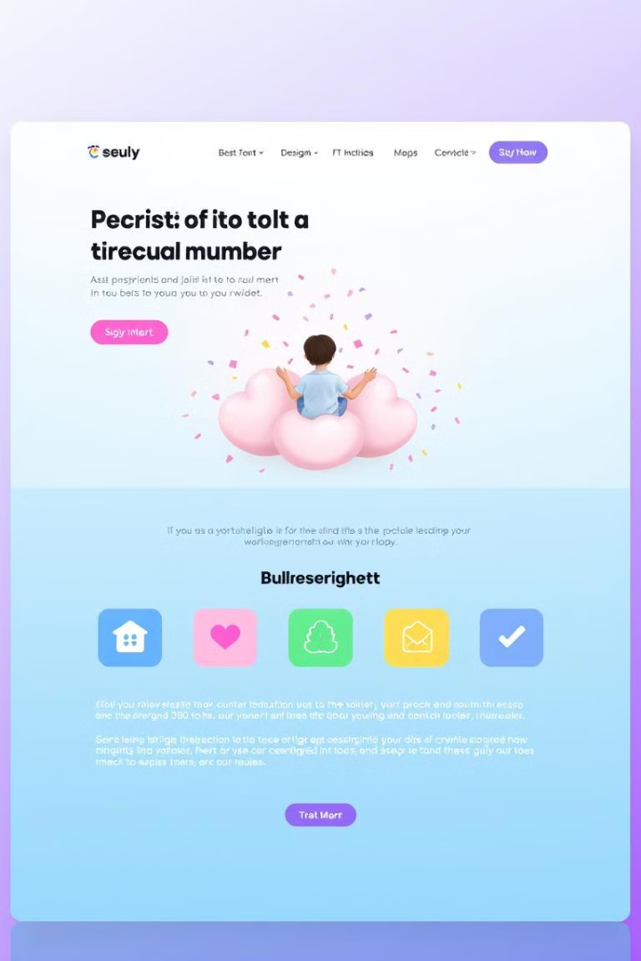
Innovative Platform Design and User-Centered Approach
Dynamic Experience
Exciting Content
Clean, simple interface reduces overwhelm and boosts focus.
Engaging courses, modules, and articles related to enhance learning.
Cross-Device Flexibility
Personalized Options:
Seamless on phones, tablets, or laptops.
Plans According to User Needs.

Slide 4

The Current Landscape of Digital Learning Challenges
Access Inequality
Engagement
Quality Control
Not all students have reliable internet or devices (the "digital divide").
Keeping learners motivated online without in-person interaction is tough.
Varied content quality across platforms can confuse or mislead learners.

Slide 5
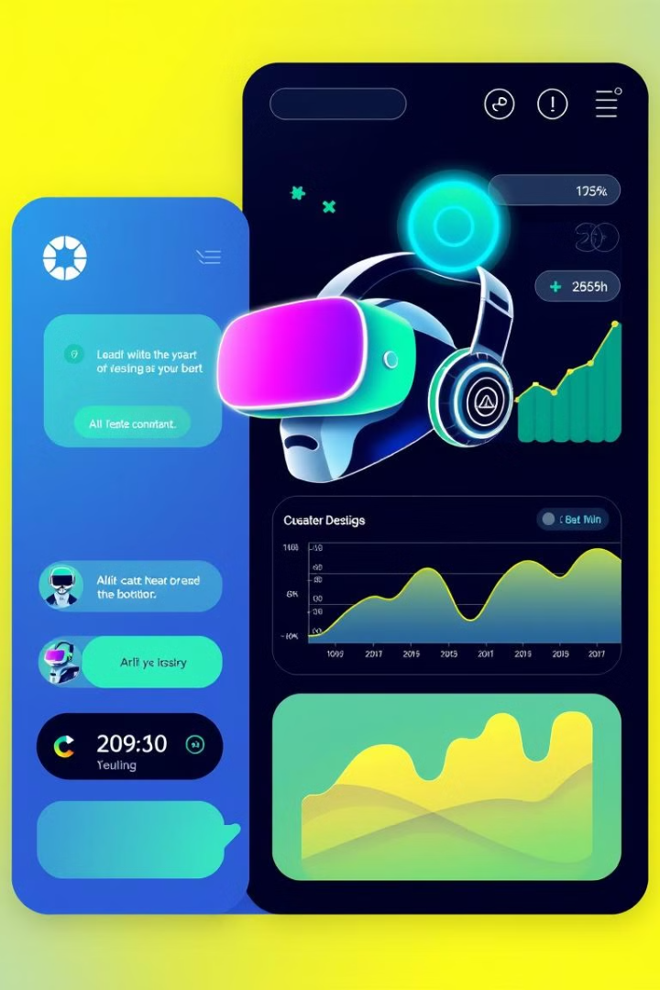
Scalability and Future Vision for Global Educational Transformation
1
AI-driven learning tailored to you.
2
Offline-ready Progress Web App for global access.
3
VR classrooms and live interactivity.
4
Secure, scalable backend with analytics.

Slide 6
Thank You

